Slide 1
Ask Me Anything
Week 7, Summer 2024. 7/31 (Wed)
Lecture 24

Slide 2
Announcements
"Official" course evaluation survey released
https://course-evaluations.berkeley.edu/Berkeley/
Filling this out will be a huge help for the Data/DSUS department with regard to course development, so please fill this out :)
Project02 ("Ants") due this Thursday (8/1)!
Ed post: "What's Left in C88C?"

Slide 3
Announcements: Final Exam
Final exam "primary" time: Wednesday August 7th, 3PM – 5 PM PST
Final exam scheduling form released
Gradescope: "(Urgent) Final Exam Scheduling"
Due: Wednesday July 31st 11:59 PM PST
Please fill this out ASAP! For more info, see Ed post.
DSP students: you should have received an email for a separate Final exam scheduling form. Please fill this out – if you didn't receive an e-mail, let us know!
Final exam will have the same style as the Midterm
Zoom+Gradescope

Slide 4
(Serious-ish) Ed Questions

Slide 5
Question
I've struggled in this class and worry about my ability to keep up in future data science / computer science courses. Is there still a place or path for me in data science / computer science?

Slide 6
Question
Any advice about how to get your 1st job in tech? What if you have a data science / other science background, instead of CS?
Answer:
Network, connections.
Internships.
There are many data science/analyst roles in tech, many of them have backgrounds in stats/data-science rather than a "traditional computer science" degree.
Idea: Work on interesting personal/side projects that demonstrate your ML/DS/CS skills in an interesting way. Ideally, an intersection of ML/DS/CS and some of your personal interests.

Slide 7
Question
Is there something Berkeley didn't teach you that, in hindsight, you wish you'd learned sooner?
Technical things:
Embrace and rely on INTUITIONS, rather than "cold hard math/numbers". Example: developing "visual" intuitions of ML/math/CS concepts rather than relying on "symbol pushing" (eg brute-forcing algebraic symbol manipulation) to prove things.
Don't be afraid of math (related to above).
Non-technical things
Learn effective organizational skills
"80 / 20" rule: "80% of the wins are due to 20% of the work". Aka learn how to prioritize things I need to do/learn. Only 24 hours in a day!

Slide 8
Question
https://cdss.berkeley.edu/academics#academicenrichment
https://cdss.berkeley.edu/data-science/student-opportunities
Data Science Discovery

Slide 9
Fun Ed Questions

Slide 10
Question
How did you decide to be a DS instructor while balancing work?

Slide 11
Question
what fun things should we do before graduating from Berkeley?!

Slide 12
Question
How did you create that sweet page

Slide 13
(Un)solicited Advice

Slide 14
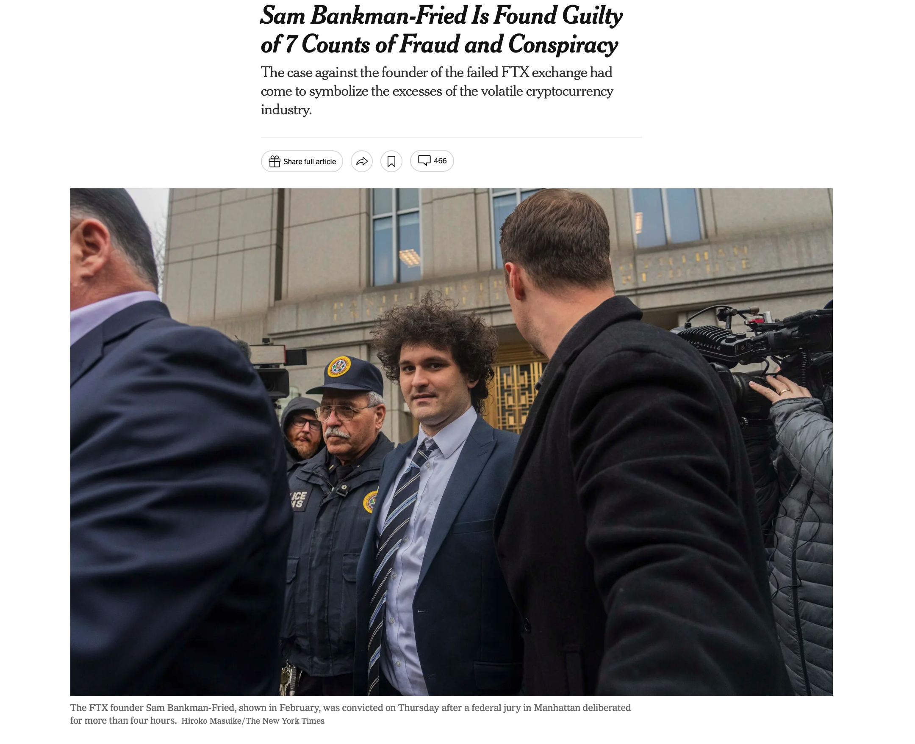
FTX / Careers / Power [NYT]
Integrity and honesty are just as important (if not more so) than technical skills.

Slide 15
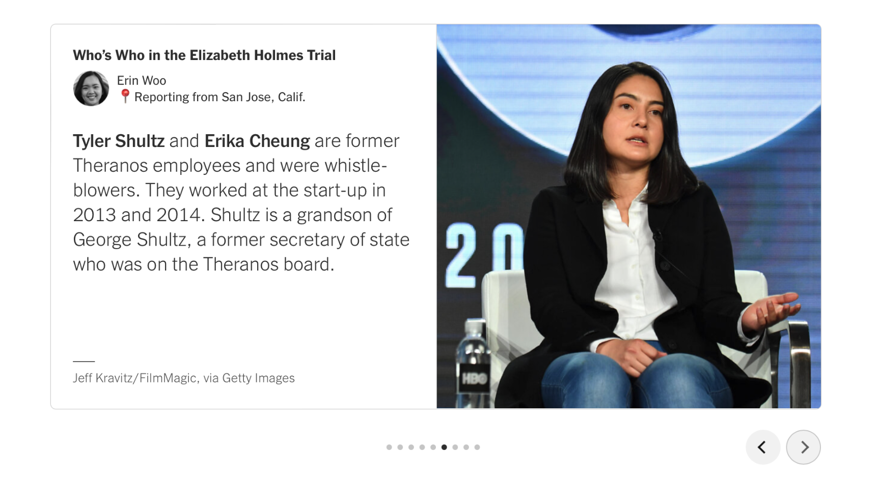
Other Corporate Scandals… Bears doing Good [NYT]

Slide 16
Overall advice
Above all: be kind
Whether you're in academia, industry, etc
Good indicator of success is: do people enjoy working with you?
Angle 1: are you good at collaborating + working with people?
Angle 2: are you agreeable / nice / kind / fun / etc?
Interestingly, I've worked (and enjoyed!) working with people with more of (1) than (2). Ideal when you have both (1) and (2) of course!

Slide 17
Overall advice: pedigree/status
UC Berkeley is a bubble
Bay Area is also a bubble
Tech/CS/DS is also a bubble
Big, big world out there!
Advice: keep an open mind when working on new problems/domains, or when working with people with all kinds of backgrounds.
"A closed-off mind is a small mind"

Slide 18
C88C teaching staff: Thank you!!

Slide 19
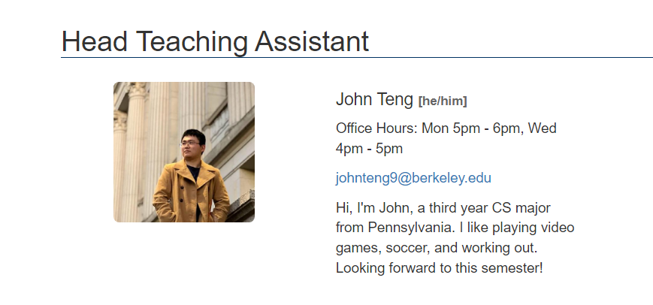
Thank you Data C88C teaching staff!
Tip: You can also find this info on the course Staff Page

Slide 20
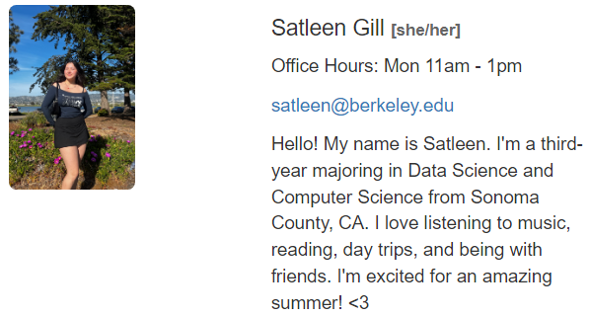
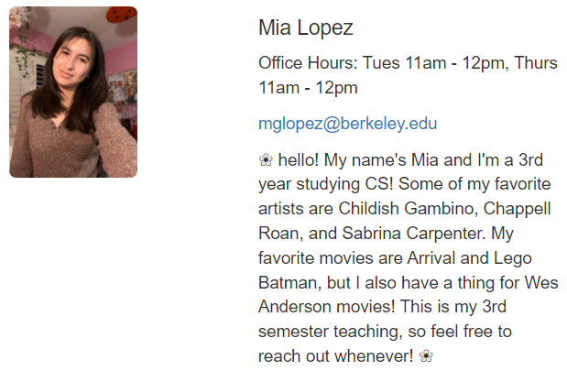
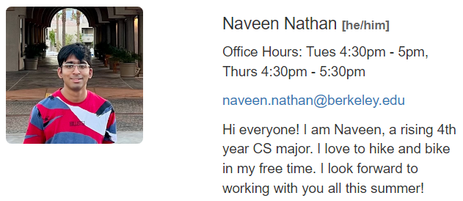
Thank you Data C88C teaching staff!
Tip: You can also find this info on the course Staff Page

Slide 21
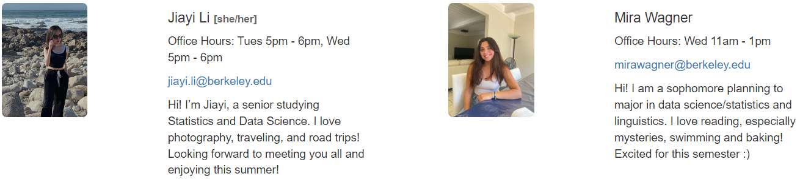
Thank you Data C88C teaching staff!
Tip: You can also find this info on the course Staff Page

Slide 22
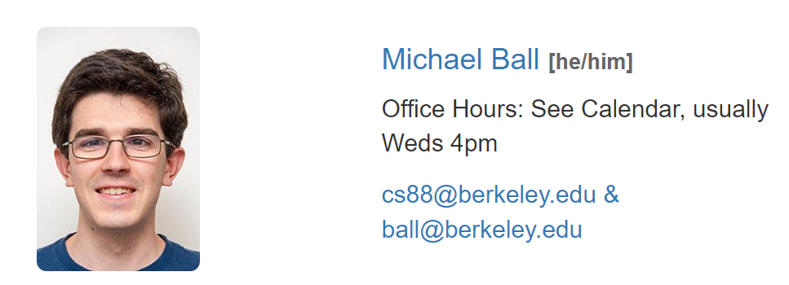
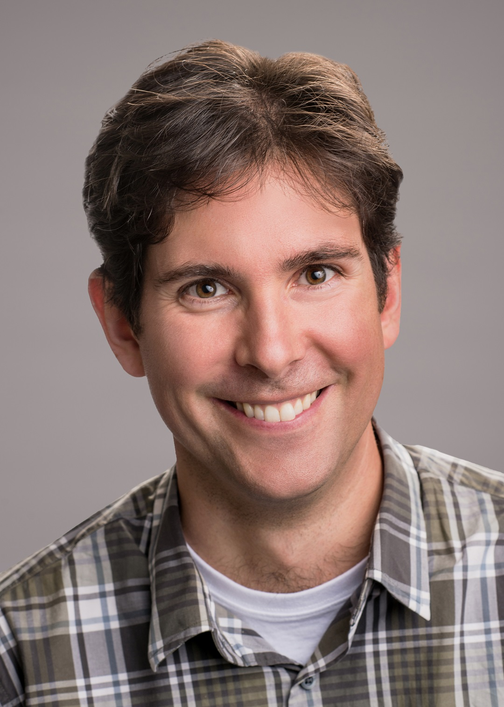
Thank you Data C88C teaching staff!
Professor John DeNero
https://denero.org/
Extra thanks to Michael Ball for developing + improving core C88C course materials, and for helping me (Eric K) onboard onto teaching this summer!

Slide 23
Anything Else?

